Slide 1
Lecture 10
Looking inside Cities: Professional Diversity and Productivity
10.2 Professional and Business Diversity and the Productivity of Cities
IUS 5
Luís M. A. Bettencourt 2023

Slide 2
Inequality and statistics of variation in cities
Resources
Information
wealth, “social capital”
knowledge, expertise
IUS Ch 6
IUS Ch 5
Neighborhoods
(Spatial sorting)
Professions
Ethnicity, Race, SES
Class, Caste, Income
Notes:
We now focus on a twin aspect of inequality, which is diversity and variations inside cities, both of business types and professions (this module) and of neighborhoods (next one). Cities are always very diverse places across many different dimensions, so we are asking if we can understand patterns of diversity as being somehow functional (not accidental).

Slide 3
Observe the accommodation of most day laborers in a civilized and thriving country, and you will perceive that the number of people of whose industry a part, though but a small part, has been employed in procuring him this accommodation, exceeds all computation. […]
if we examine, all these things, and consider what a variety of labour is employed about each of them, we shall be sensible that without the assistance and co-operation of many thousands, the very meanest person in a civilized country could not be provided
Adam Smith (wealth of nations, ch 2)
Notes:
This module will be about the economic structure of cities. From the beginning of economics, Adam Smith saw the division of labor (the many interdependent professions) in cities as the source of the wealth of nations ! The fact that production is such a complex and distributed system is often lost on more contemporary approaches.

Slide 4
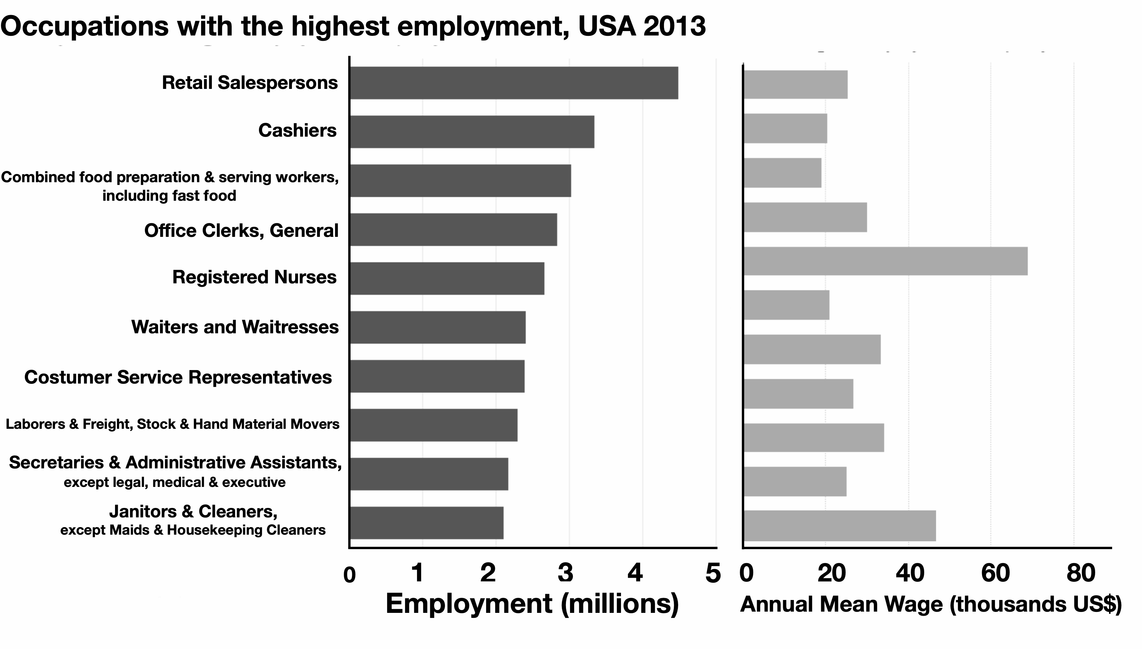
IUS Fig 5.7
Notes:
This is just to warm us up, I like to ask what is the most common profession in the US (note that this is pre-COVID).

Slide 5

resolution
Notes:
And this is how it is measured: The bureau if labor statistics (see book for more details) classifies professions hierarchically in terms of levels of resolution (r_s) both for businesses and professions. Level 6 is the deepest (most detailed).

Slide 6
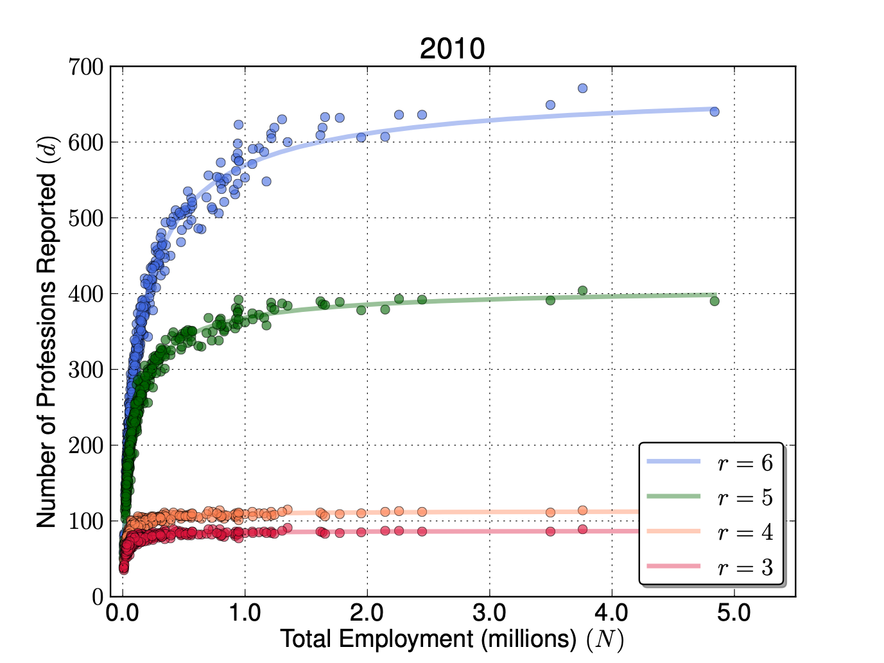
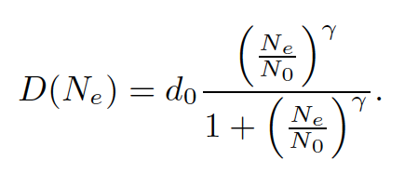
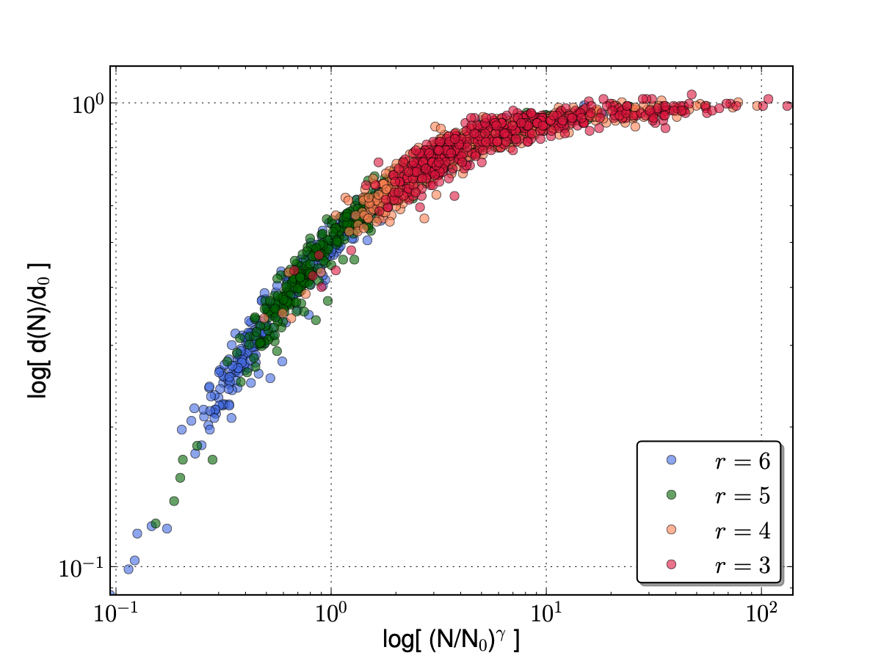
Professional Diversity and Classification Resolution
# of different occupations in US Metropolitan Statistical Areas
resolution
A good fit at all resolutions:
occupation richness: count different professions
This is the same curve but with different parameters
$$γ=1-δ≃\frac{5}{6}$$
IUS Fig 5.9
https://www.nature.com/articles/srep05393
Notes:
This shows a simple plot of number of unique professions in US MSAs in 2010 at different resolutions and power law plus saturation fit, D(N_e). This is sometimes called occupational (or professional) richness, by analogy with species richness in ecosystems. The question this suggests is whether the actual diversity is being curtailed by not enough resolutions, note that the curves saturate later and at high number of professions as resolution increases. What is the limit of infinite resolution?

Slide 7
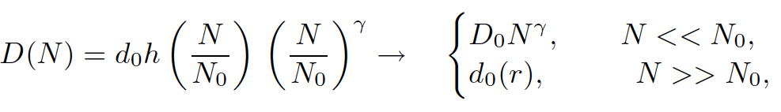
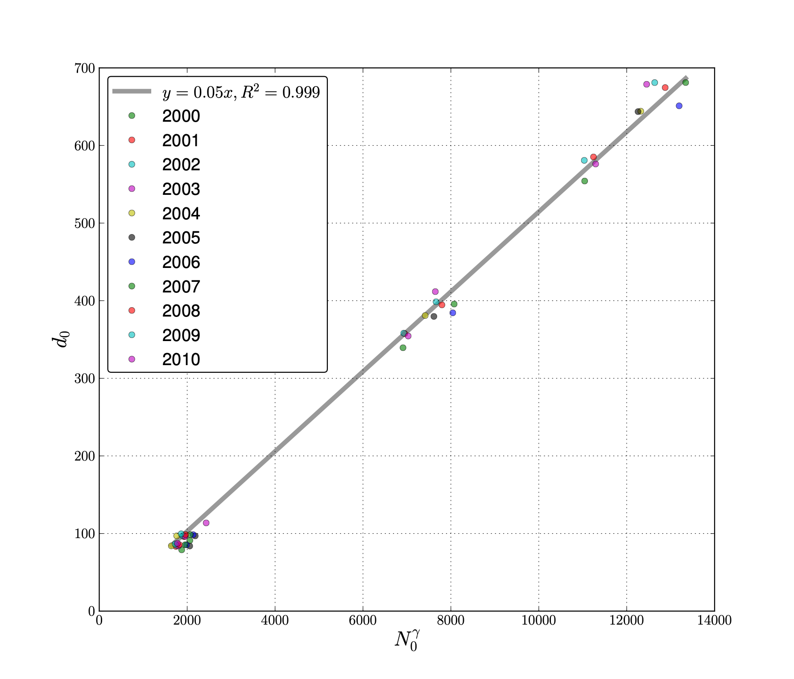
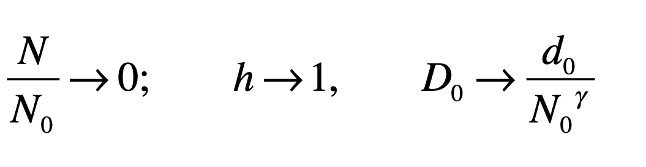
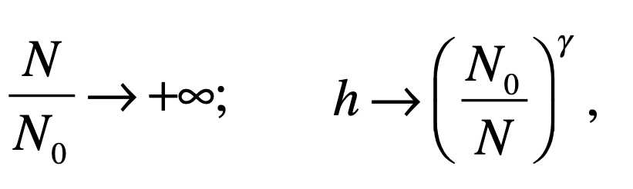
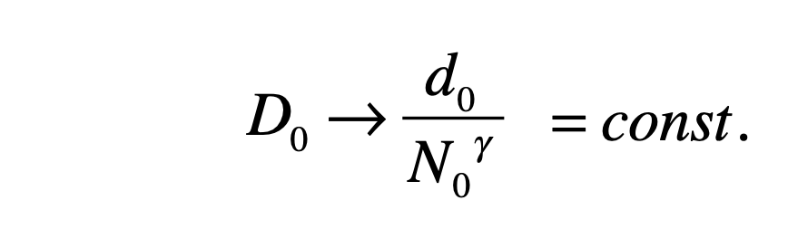

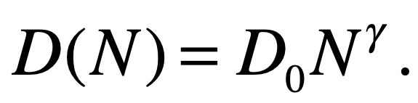
Inferring actual diversity D(N):
In the limit of no saturation:
In the limit of full saturation:
Test !
A scaling limit exists if:
with
https://www.nature.com/articles/srep05393
Notes:
This shows that there a limit that corresponds to the (non-saturating) power law. For this limit to exist the fit parameters but covary to produce the same D_0, as observed. This is how to obtain (potentially) infinite resolution data from several finite resolution results !

Slide 8
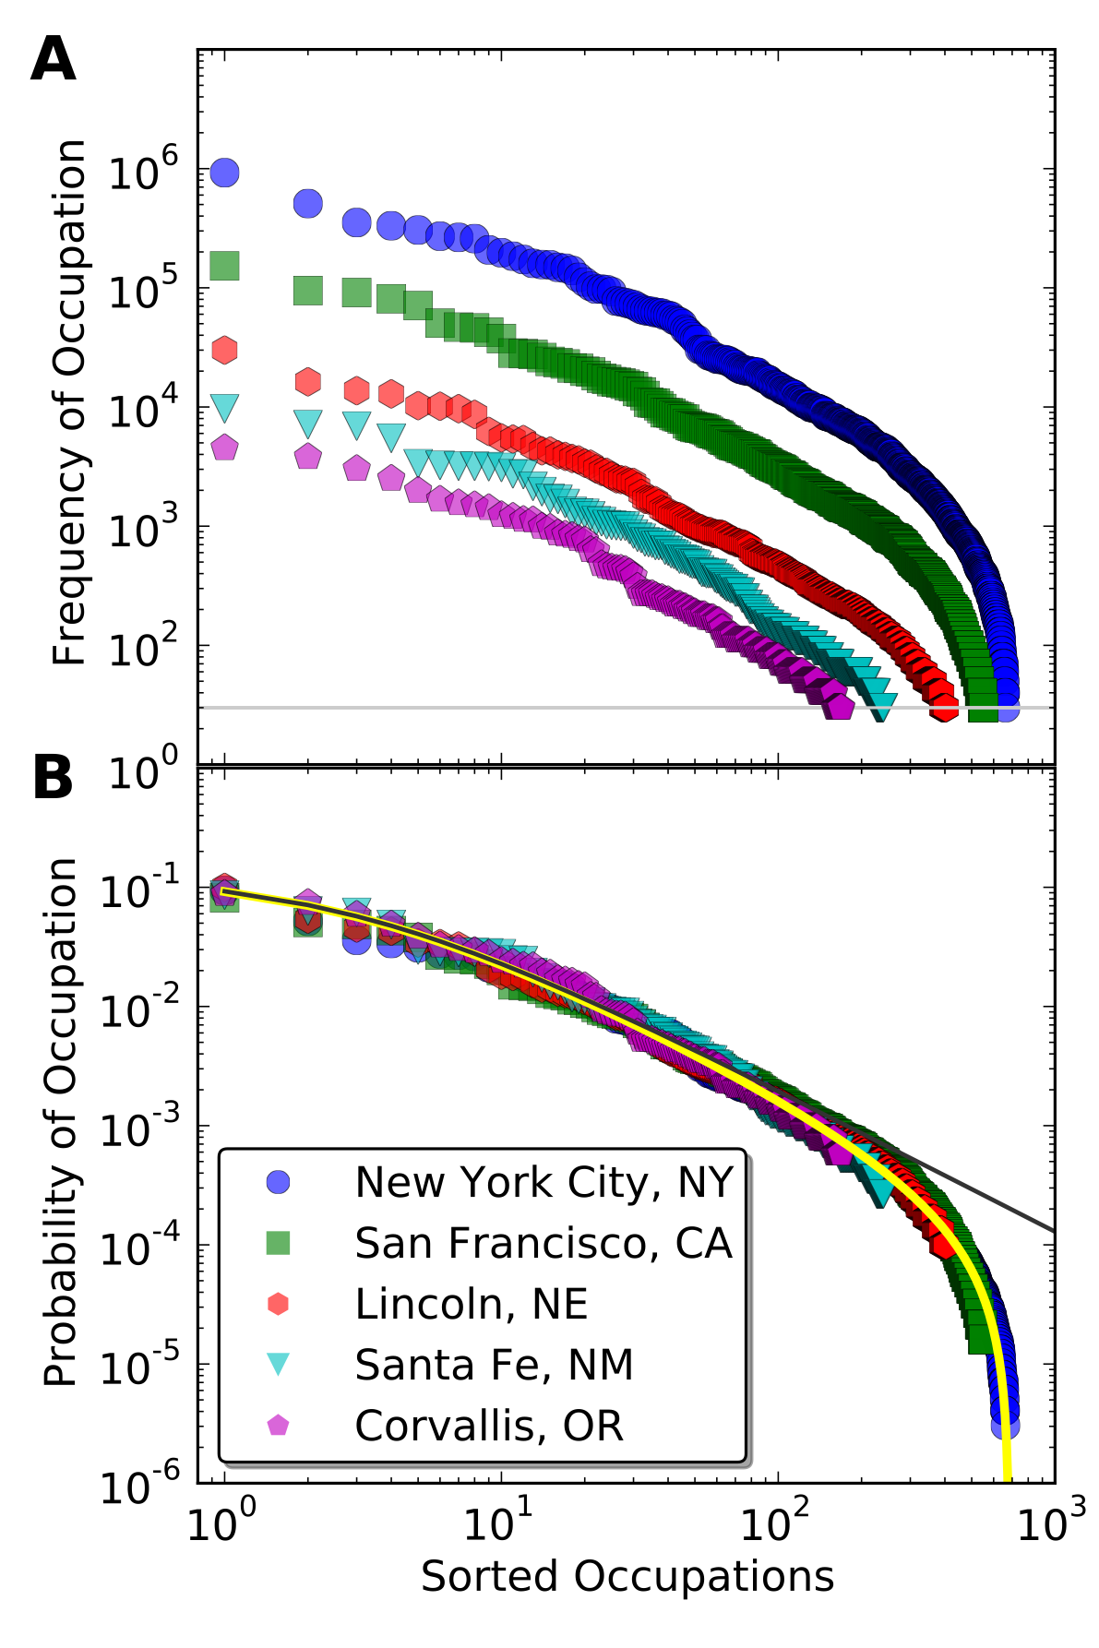
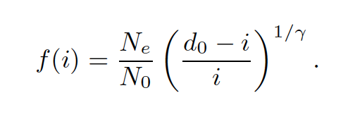
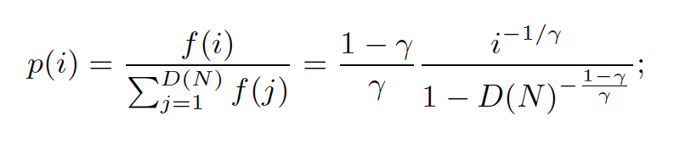
The distribution of professions (more common / less common)
IUS Fig 5.10
From D(N), for all N, derive frequency distribution
Universality!
https://www.nature.com/articles/srep05393
Notes:
This result also implies that the ranked abundance of professions is a universal function, the same for all cities. Because there is a lower threshold (one person per occupation) new professions appear only as cities are bigger…

Slide 9
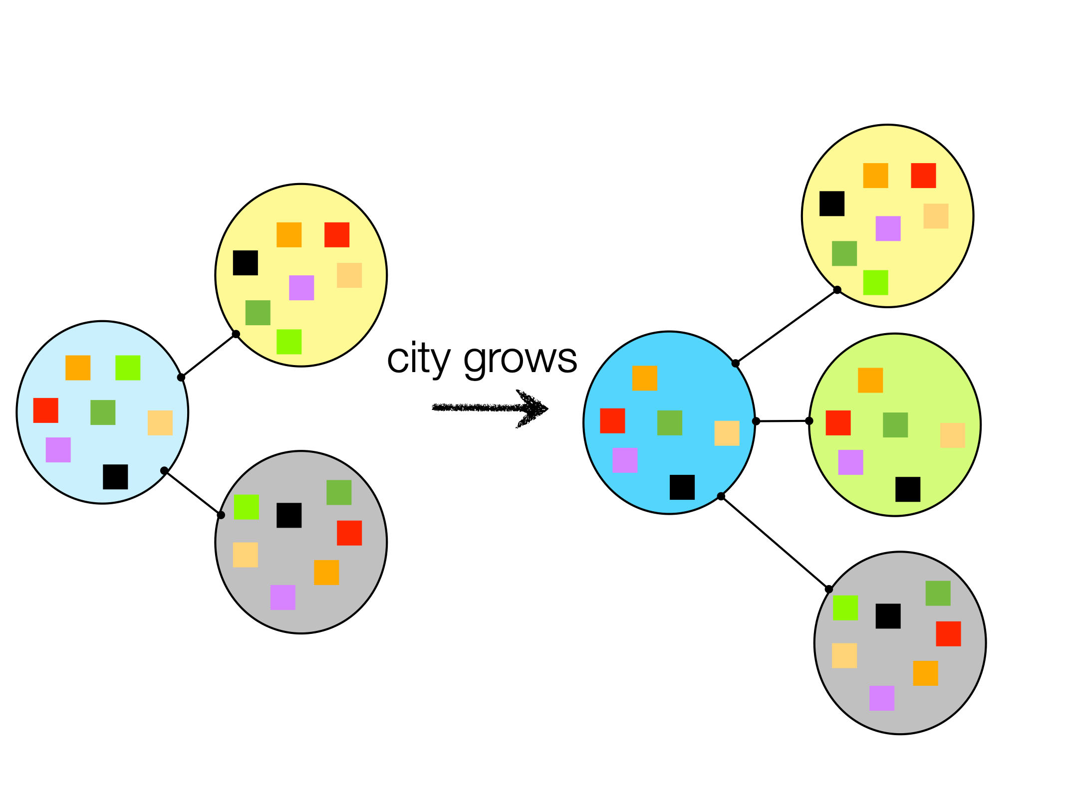
Professional Diversity and Urban Productivity (back to Adam Smith)
Specialization as the Division of Labor
as sources of increases in urban productivity
$$D/N=D_{0}N^{-δ}$$
Diversification comes from specialization
specialization
$$y=Y_{0}N^{δ}=GI(N)$$
interactions per capita
productivity
Less specialization
Less information
Less productivity
More specialization
More information
Greater productivity
$$y(N)*\frac{D(N)}{N}=F$$
This tells us that there is an invariant quantity (total functions):
independent of city size
better quality, more segmented functions
In a larger city I get more different things from more different people,
to satisfy same needs
https://www.nature.com/articles/srep05393
Notes:
So we deduce a very interesting result: That the number of professions scales as N^\gamma, \gamma ~5/6, which is the complement of the number of connections, which facilitate specialization and interdependence. As the latter expand as expected by urban scaling theory, the former adjust creating greater specialization and more and more professions. It’s beautiful that we can predict aspects of the division of labor based on the statistics of the social networks of cities.

Slide 10
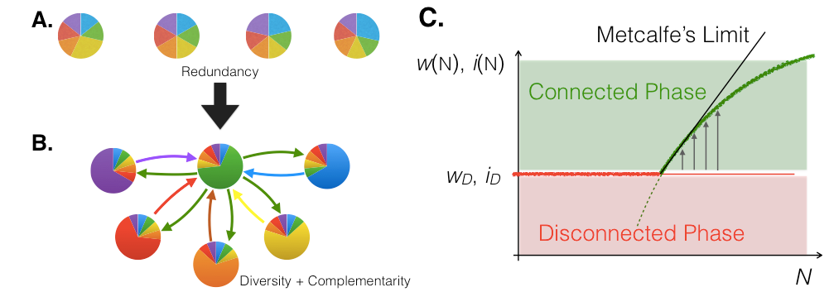
Generalizing: Information, Connectivity & Productivity
Poor
Jack/Jane of all trades
Urban societies
Subsistence societies
Rich
Interdependent, dynamical
overload
IUS Fig 5.13
IUS Fig 5.12
https://mae.engr.ucdavis.edu/dsouza/Pubs/PIEEE_vol102_12.pdf#page=8
Notes:
This has larger consequences, that larger cities beget more complex economies with greater specialization (more knowledge) and interdependency. By contrast poor societies (and people) tend to be less well connected and Jacks of all trades. A society will become connected when the costs of interaction, which are higher, can be overcome because they scale like the benefits of connections. This is a generalization of the arguments of urban scaling theory, now to economic complexity and information.

Slide 11
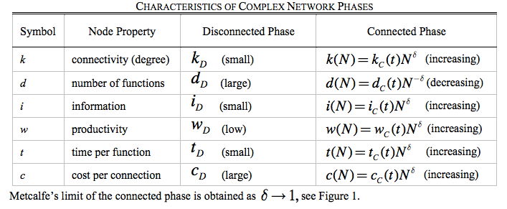
A Network Theory of Development:
Interconnected human societies
contain more information at higher connectivity costs
IUS Table 5.3
https://mae.engr.ucdavis.edu/dsouza/Pubs/PIEEE_vol102_12.pdf#page=8
Notes:
We can posit the characteristics of this process, including that people who specialize spend more time per task and can learn it better. Note that a society with very high connection costs (and lower productivity connections), because for example of violence and lack of trust, lack of infrastructure and services and so on, may not realize these benefits for most people.

Slide 12
In a real sense all life is inter-related.
All people are caught in an inescapable network of mutuality, tied in a single garment of destiny.
Whatever affects one directly, affects all indirectly.
I can never be what I ought to be until you are what you ought to be, and you can never be what you ought to be until I am what I ought to be…
This is the inter-related structure of reality.
- Martin Luther King Jr, Letter from Birmingham Jail.
Notes:
I find this quote from MLK (more philosophical than our considerations so far) very important in this respect. It is not just about what people do in some utilitarian way, but more fundamentally who they can and cannot become.

Slide 13
Business Diversity
Notes:
Like professions, business diversity increases with city size, but the process is less universal.

Slide 14
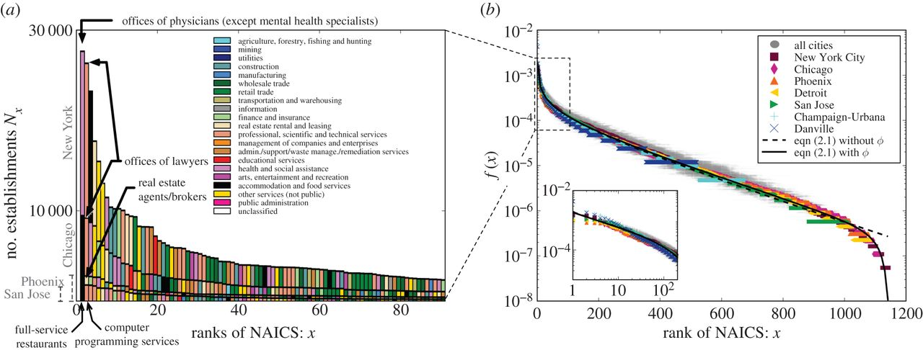
Establishment Types
Youn et al 2016
Notes:
Here’s what the frequency distribution of ‘establishments’ looks like for several cities.

Slide 15
Rank Establishment Types
Youn et al 2016
Notes:
And here is its “universal” distribution

Slide 16
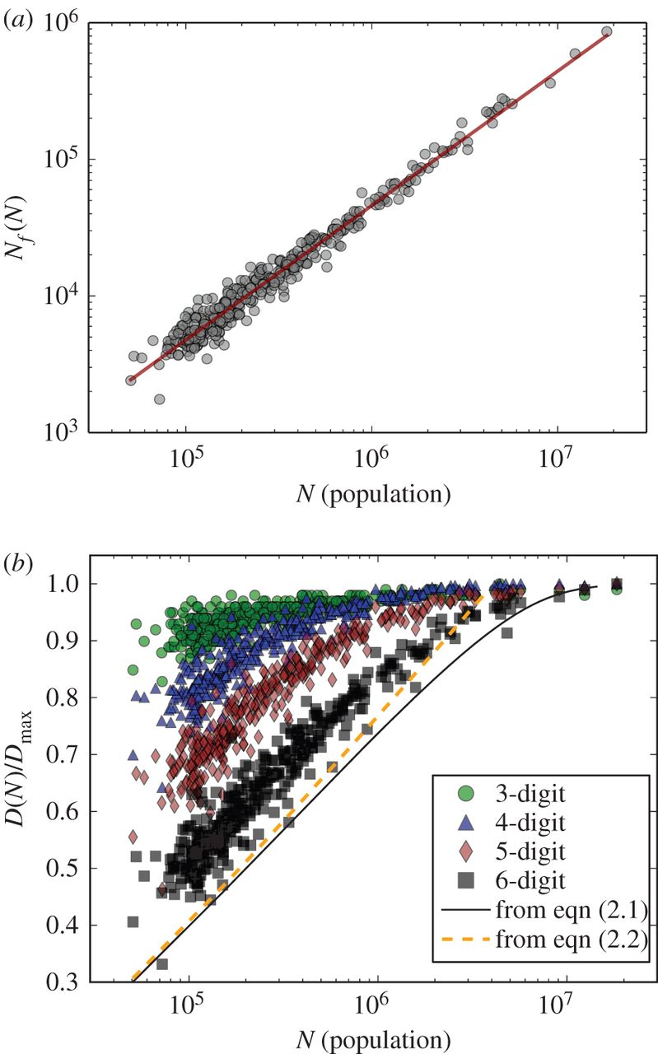
number of establishments
# establishments types
Youn et al 2016
Notes:
The number of establishments is approximately linear (and so are jobs) on population, but types increase approximately like the logarithm of size.

Slide 17
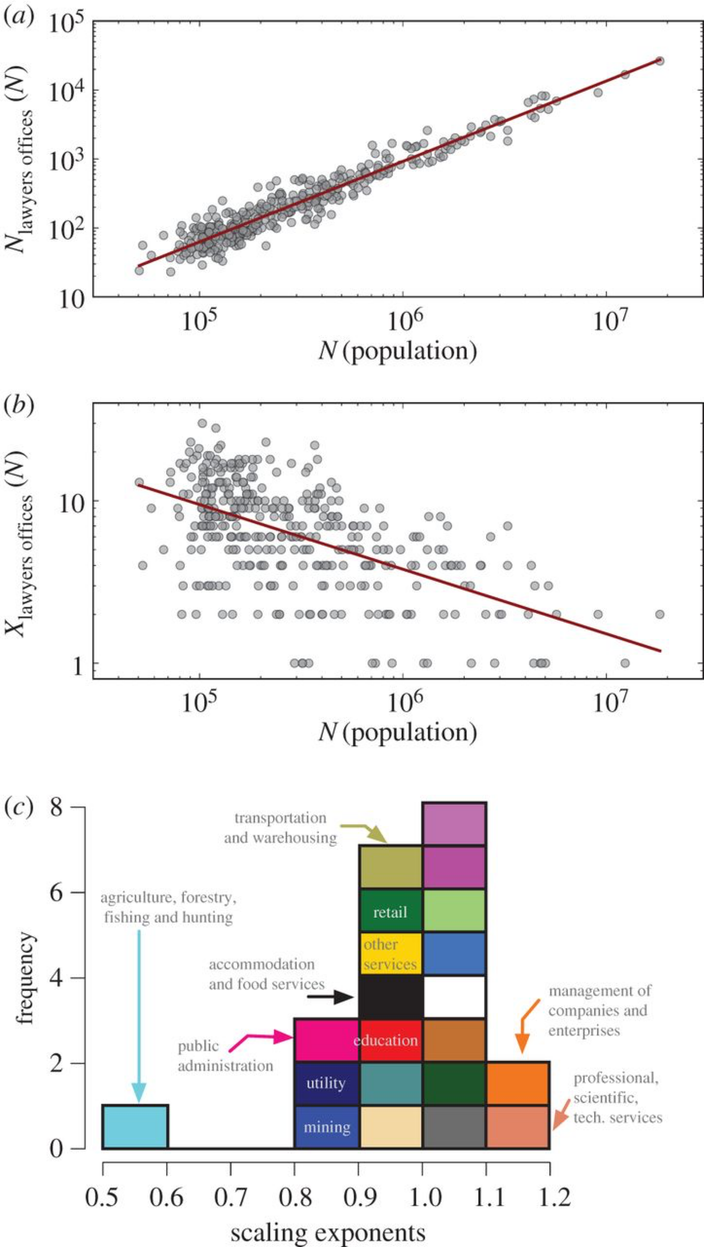
Scale each business type on population
Number of Lawyers Offices
Rank of Lawyers Offices
Youn et al 2016
Notes:
Curiously some professions increase super linearly and other sub linearly. No surprise that lawyers offices are superlinear …

Slide 18
Youn et al 2016
Notes:
And here is the types of exponents you get by sector. This means that larger cities are more about professional, scientific, management and less about primary sector…

Slide 19
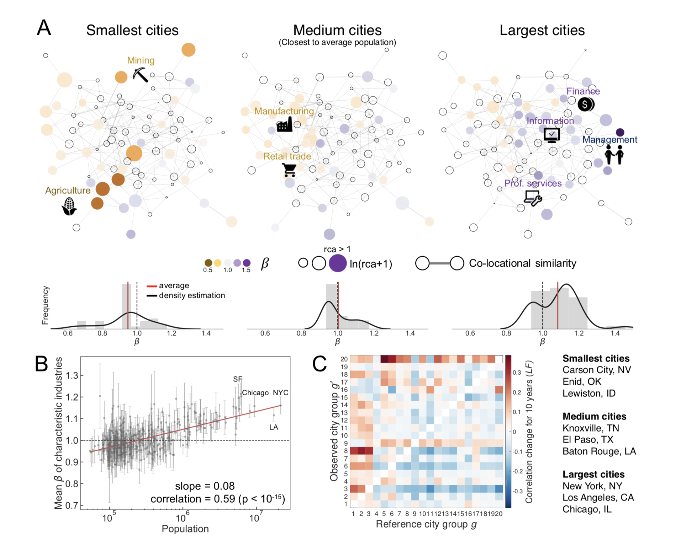
Recapitulation of Business Sectors
Hong et al 2018
Notes:
This pattern is also recapitulated in time as cities develop, so that business ecologies assemble.

Slide 20
Functional Diversity is related to Complementarities
Division of labor, knowledge, interdependence
Second reason (Marshall) for agglomeration economies
This creates an “ecology” of functions in cities that is quantitatively predictable, with small cities disproportionally dedicated to primary sectors
and large cities to informational activities
Interactions, degree of specialization and economic productivity are facets of a structural transformation predicted by urban scaling
Notes:
So the structure of urban economies is quiet predictable, and a function of greater interactions.

